Slide 1

Apartment rental system
BHUMIKA PUNJABI – 001061256
PRANATHA RAJPRASADRAO - 001388642
Prashant Pancholi – 001053361
Ajinkya Joshi - 001388300
Amey BHIvshet - 001383083

Slide 2
Objectives
To produce a web-based system that allow users to register and subscribe for receiving various updates regarding available accommodation options.
To ease user’s task whenever they need to rent a unit.
To transform the manual process of renting a house to an online and computerized system.
To validate the house rental system using user feedback and testimonies .
To produce the documentation such as Software Requirement specification, Software Design Description and Software Development References

Slide 3
Design approach
Customer Table
Customer table shares an identifying ‘one to many’ relationship with the table ‘Payment Info’ and identifying ‘one to optional one’ relationship with the table ‘Finance’.
Vehicle Table
It has an identifying One to Optional One Relationship with Delivery Table. Also, it has an identifying One to Many Relationship with Service and Accessories Table. It has a non –identifying One to Many Relationship with the Store Location Table.
Service Table
It has identifying ‘many to one’ relationship with Vehicle and Customer Service Center table.
Payment Info
It has a ‘optional many to one’ relationship with the Customer table.

Slide 4
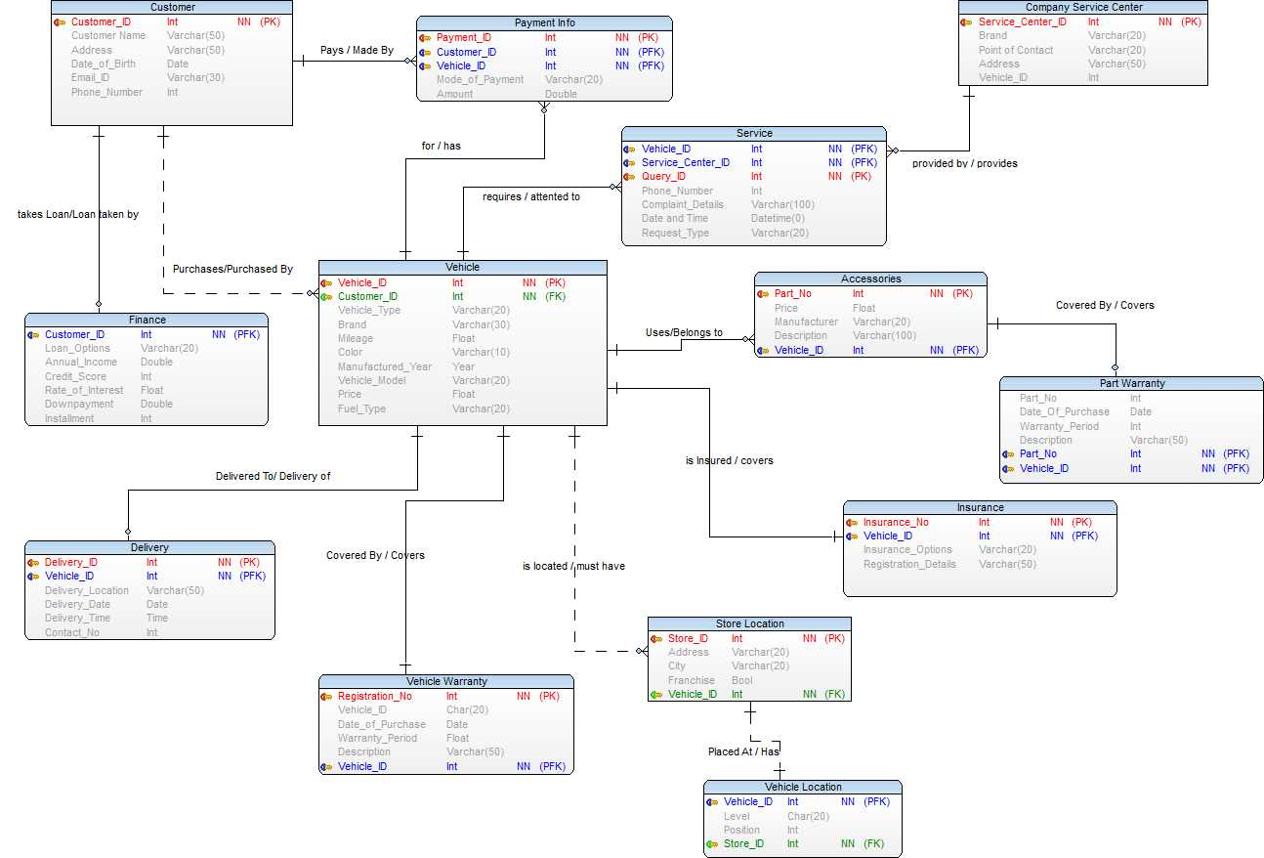
ENTITY – Relationship Diagram

Slide 5
DDL And DML STATEMENTS
CREATE TABLE Customer
(
CustomerID int not null,
CustomerName nvarchar(100),
CustomerAddress varchar(250),
CustomerDateOfBirth date,
CustomerEmailID varchar(250),
CustomerPhone bigint
CONSTRAINT Customer_PK primary key (CustomerID)
);
INSERT [dbo].[Customer] ([CustomerID], [CustomerName], [CustomerAddress], [CustomerDateOfBirth], [CustomerEmailID], [CustomerPhone]) VALUES (16828, N'Maryann Royster', N'74 S Westgate St', CAST(N'1980-05-01' AS Date), N'mroyster@royster.com', 5189667987)
INSERT [dbo].[Customer] ([CustomerID], [CustomerName], [CustomerAddress], [CustomerDateOfBirth], [CustomerEmailID], [CustomerPhone]) VALUES (17449, N'Josephine Darakjy', N'4 B Blue Ridge Blvd', CAST(N'1970-07-31' AS Date), N'josephine_darakjy@darakjy.org', 8102929388)
INSERT [dbo].[Customer] ([CustomerID], [CustomerName], [CustomerAddress], [CustomerDateOfBirth], [CustomerEmailID], [CustomerPhone]) VALUES (18250, N'Abel Maclead', N'37275 St Rt 17m M', CAST(N'1995-05-19' AS Date), N'amaclead@gmail.com', 6313353414)

Slide 6
DDL And DML STATEMENTS
Create table Vehicle
(
VehicleID int not null,
CustomerID int not null,
VehicleType varchar(100),
Brand varchar(100),
Mileage float,
Color varchar(50),
ManufacturedYear varchar(10),
VehicleModel varchar(100),
Price float,
FuelType varchar(100)
CONSTRAINT Vehicle_PK PRIMARY KEY (VehicleID),
CONSTRAINT Customer_FK FOREIGN KEY (CustomerID) References Customer(CustomerID));
INSERT [dbo].[Vehicle] ([VehicleID], [CustomerID], [VehicleType], [Brand], [Mileage], [Color], [ManufacturedYear], [VehicleModel], [Price], [FuelType]) VALUES (1219315, 53044, N'SUV', N'Honda', 20, N'Silver', N'2017', N'LX Sport Utility', 29100, N'Petrol')
INSERT [dbo].[Vehicle] ([VehicleID], [CustomerID], [VehicleType], [Brand], [Mileage], [Color], [ManufacturedYear], [VehicleModel], [Price], [FuelType]) VALUES (1268666, 32101, N'Hatchback', N'Volkswagen', 24, N'Black', N'2016', N'Beetle 1.8T Dune', 19300, N'Petrol')

Slide 7
DDL And DML STATEMENTS
Create Table Service
(
QueryID int not null,
VehicleID int not null,
ServiceCenterID int,
PhoneNumber bigint,
ComplaintDetails varchar(500),
[DateTime] datetime,
RequestType varchar (100),
CONSTRAINT Service_PK PRIMARY KEY (QueryID),
CONSTRAINT Vehicle_FK FOREIGN KEY (VehicleID) References Vehicle(VehicleID),
CONSTRAINT ServiceCenter_FK FOREIGN KEY (ServiceCenterID) References CompanyServiceCenter(ServiceCenterID));
INSERT [dbo].[Service] ([QueryID], [VehicleID], [ServiceCenterID], [PhoneNumber], [ComplaintDetails], [DateTime], [RequestType]) VALUES (18963, 1322951, 33836, 2025550183, N'Music system not functioning properly', CAST(N'2019-03-12T17:00:00.000' AS DateTime), N'Company Service Center')
INSERT [dbo].[Service] ([QueryID], [VehicleID], [ServiceCenterID], [PhoneNumber], [ComplaintDetails], [DateTime], [RequestType]) VALUES (23149, 1330631, 57463, 2025550143, N'Back camera not working', CAST(N'2020-04-26T14:24:00.000' AS DateTime), N'On ground')

Slide 8
DDL And DML STATEMENTS
Create table Insurance
(Insurance_no bigint not null,
VehicleID int not null,
Insurance_Options varchar(200) CHECK (Insurance_Options IN('State Farm','GEICO','Allstate','Progressive Corporation','USAA')),
Registration_Details varchar(100)
CONSTRAINT Insurance_PK primary key (Insurance_no),
CONSTRAINT Insurance_FK foreign key (VehicleID) references Vehicle (VehicleID)
);
INSERT [dbo].[Insurance] ([Insurance_no], [VehicleID], [Insurance_Options], [Registration_Details]) VALUES (1174204789, 1290071, N'Progressive Corporation', N'2015, OH')
INSERT [dbo].[Insurance] ([Insurance_no], [VehicleID], [Insurance_Options], [Registration_Details]) VALUES (2238599301, 1327724, N'State Farm', N'2018, GA')
INSERT [dbo].[Insurance] ([Insurance_no], [VehicleID], [Insurance_Options], [Registration_Details]) VALUES (2446086723, 1328639, N'State Farm', N'2017, CL')

Slide 9
Stored Procedures
GETREMAININGAMOUNT: Remaining amount of the payment for the vehicle.

Slide 10
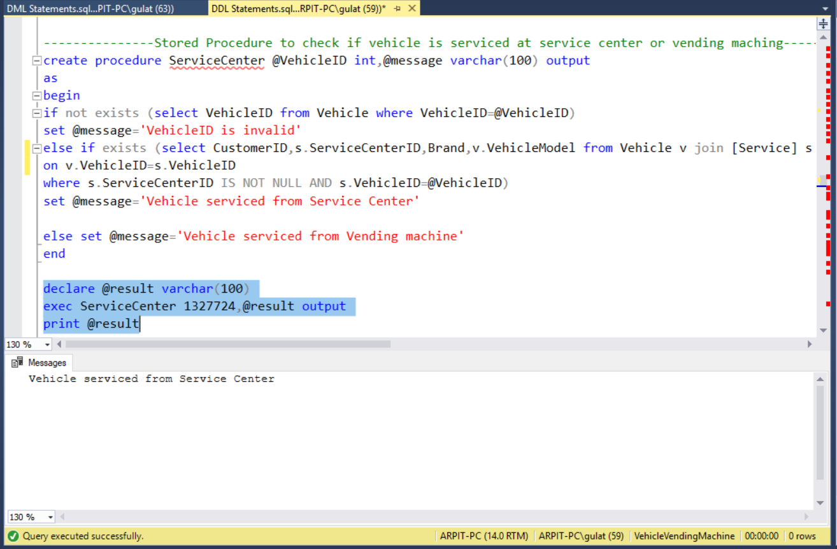
Stored Procedures
ServiceCenter: Shows whether the vehicle is serviced by Company Service Center or Vending Machine Service Center.

Slide 11
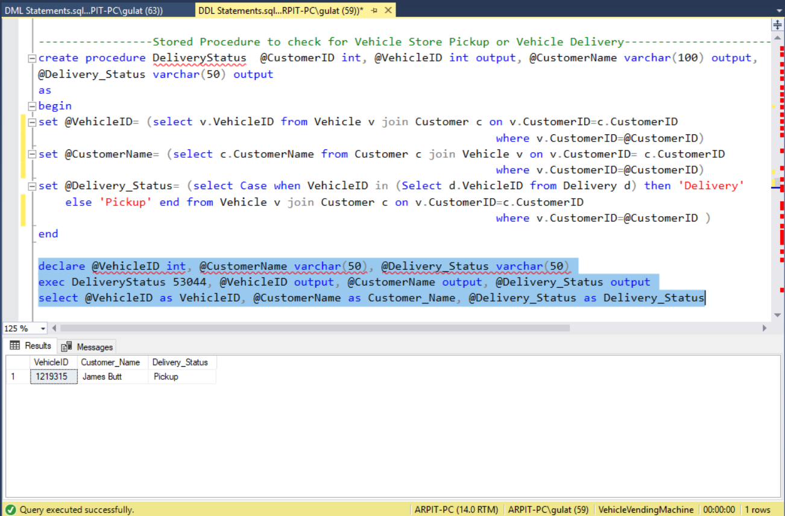
Stored Procedures
DeliveryStatus: It shows if the customer has got the vehicle delivered or opted for pickup from the vending machine.

Slide 12
Stored Procedures
VehicleRating: The procedure outputs the vehicle safety rating after performing crash tests.

Slide 13
User defined functions
GetVehicle: The function returns all the vehicles with similar VehicleType.

Slide 14
User defined functions
GetPartDetails: Returns all the part details by taking Part Number as input.

Slide 15
Views
WarrantyEnd: Returns a table with warranty end date by calculating it from purchase date and warranty period.

Slide 16
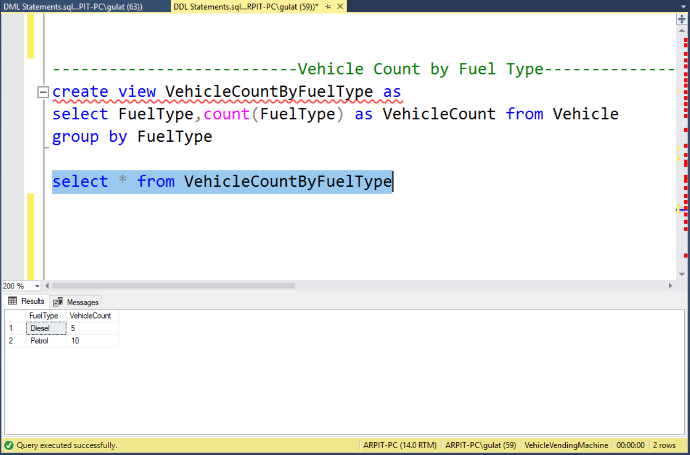
Views
VehicleCountByFuelType: Returns the count of vehicles depending on fuel type.

Slide 17
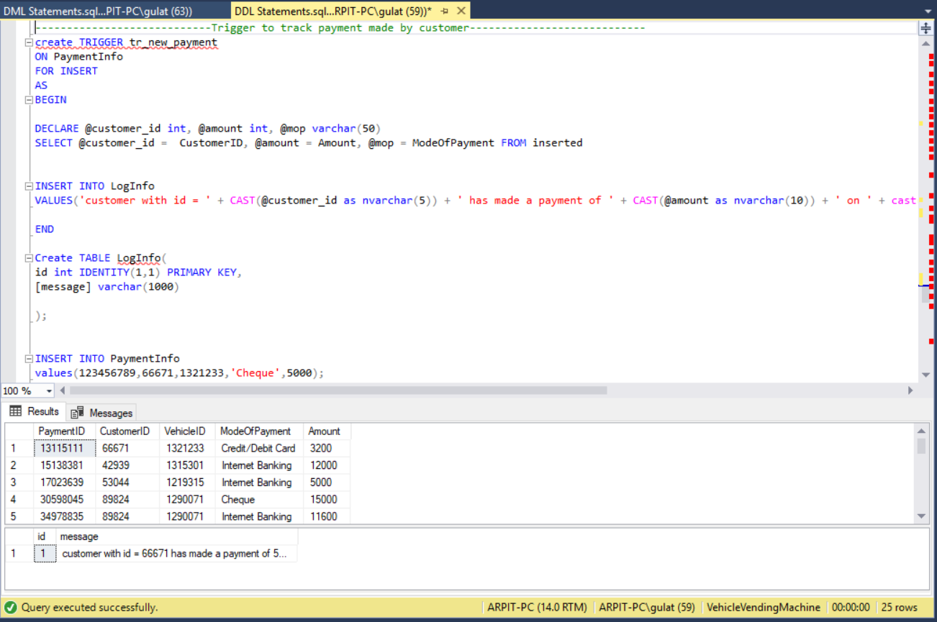
TRIGGER
tr_new_payment: Tracks payment made by customer and stores a log in a table.

Slide 18
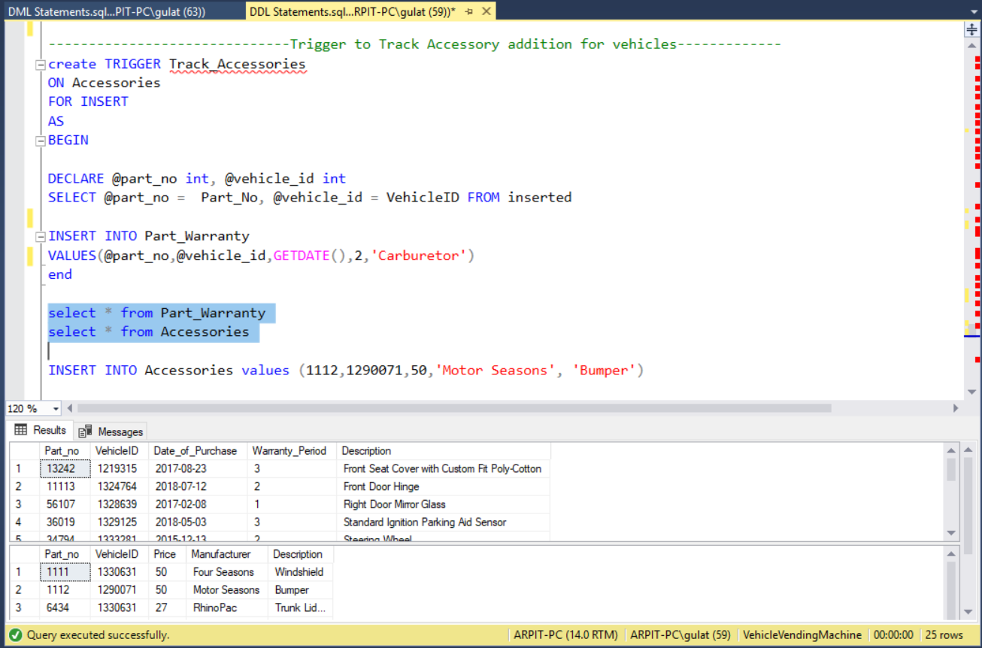
TRIGGER
Track_Accessories: Track accessory addition to parts inventory.

Slide 19
Column data encryption
Column Data Encryption on Credit Score of Customer .

Slide 20
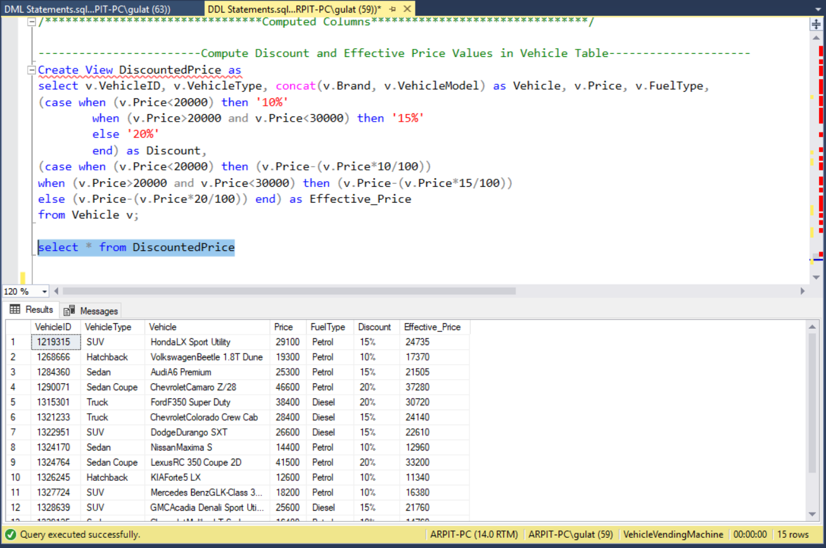
Computed columns
Compute Discount and Effective Price Values in Vehicle Table

Slide 21
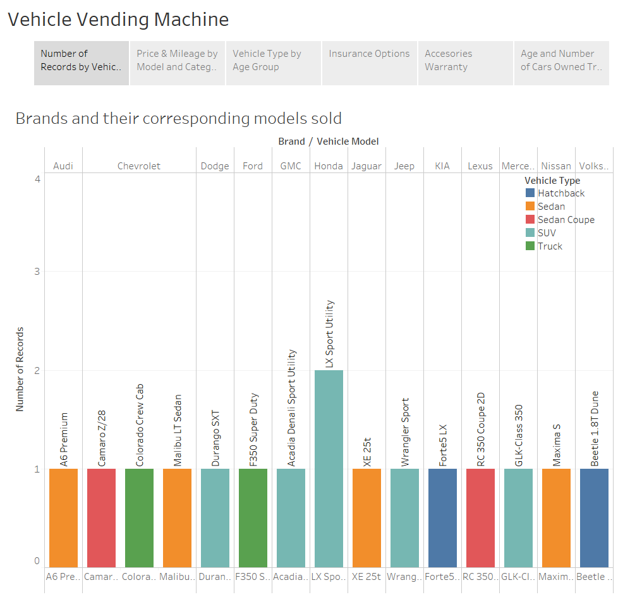
Tableau dashboards

Slide 22
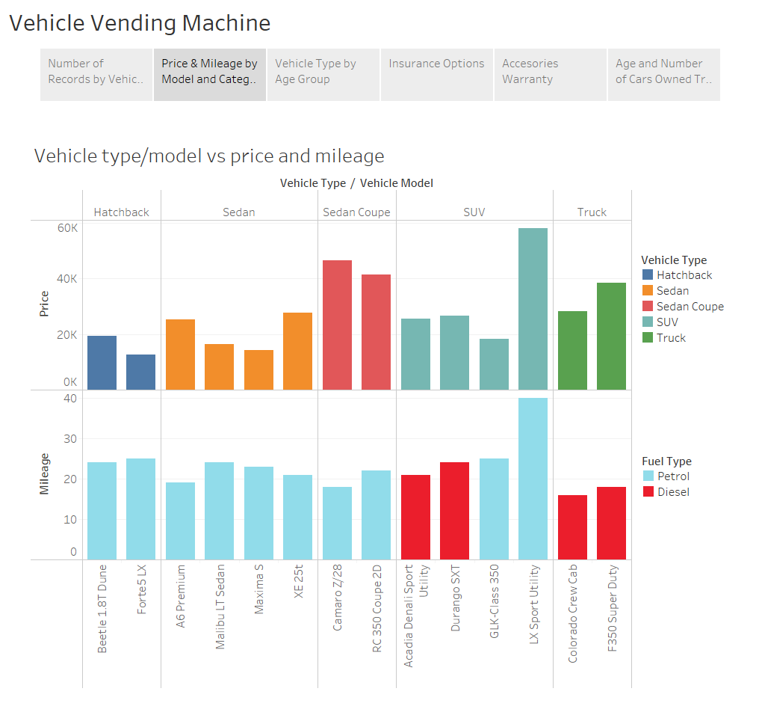

Slide 23
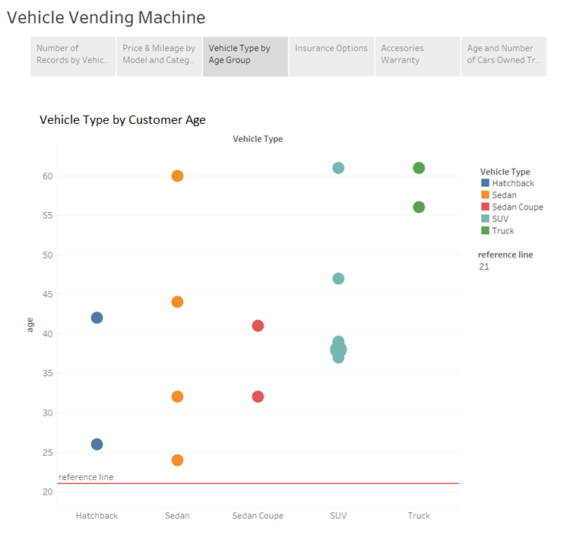

Slide 24
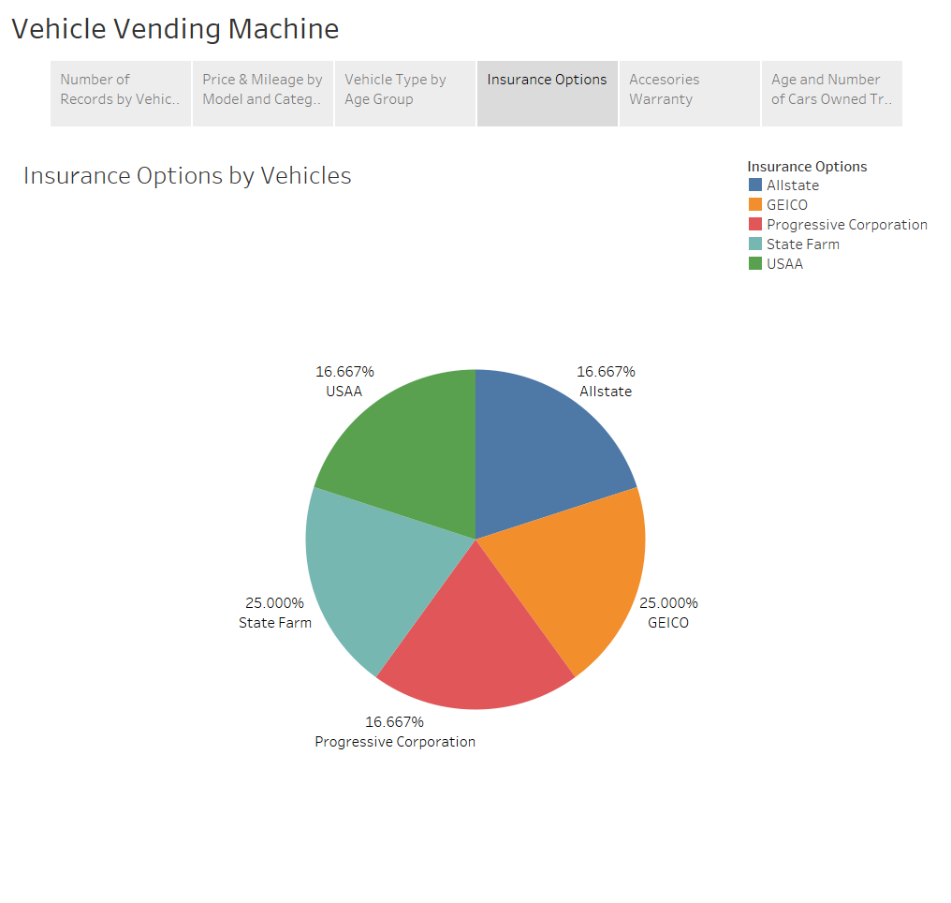

Slide 25
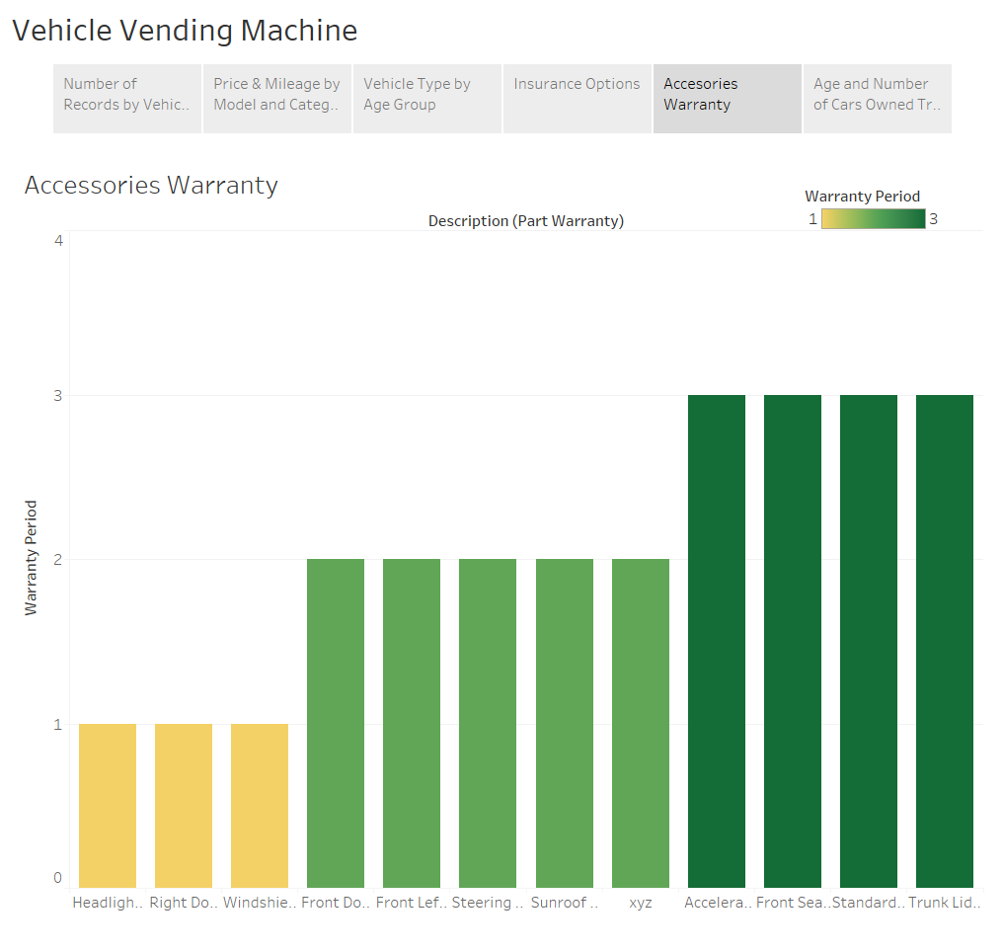

Slide 26
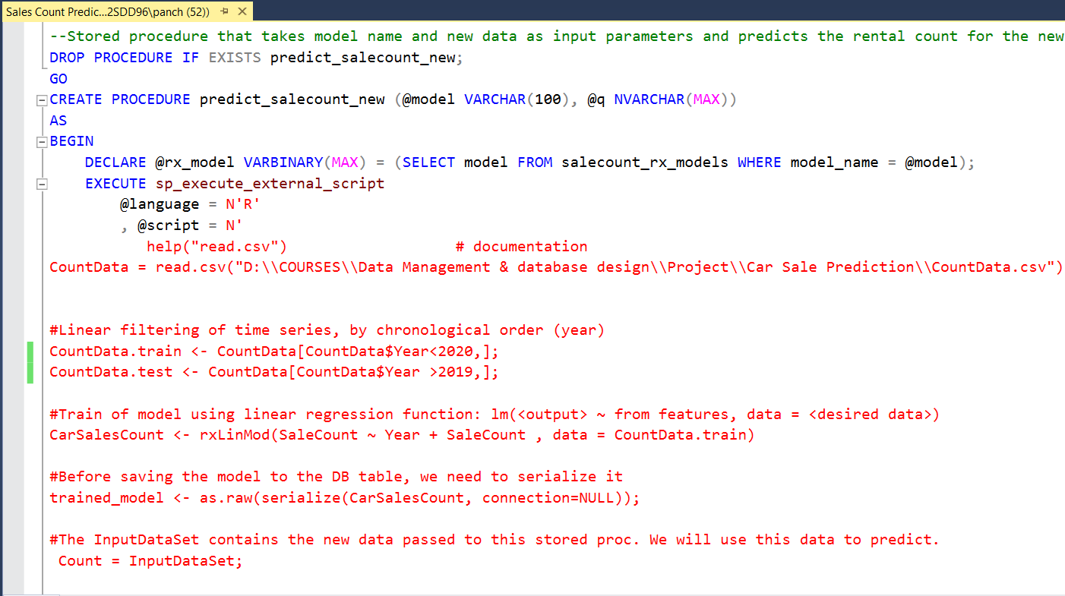
LINEAR REGRESSION SALE PREDICTION MODEL USING SQL ML SERVICES WITH R

Slide 27
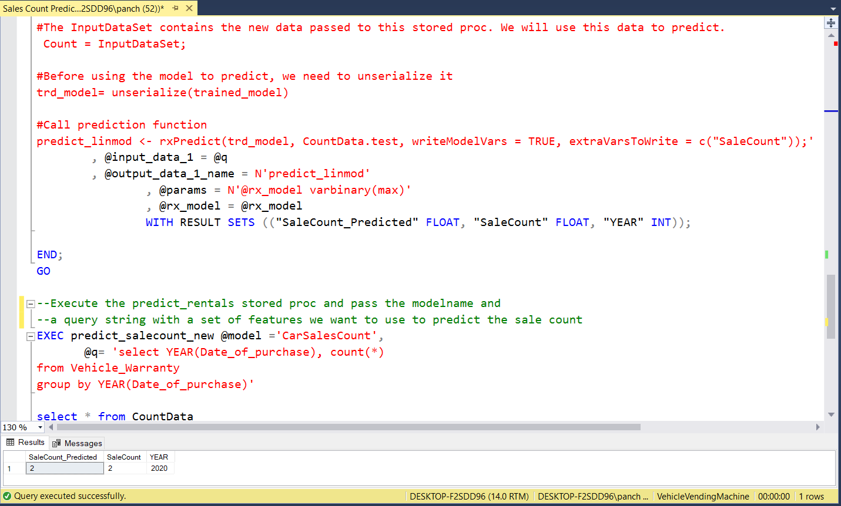

Slide 28

Thank you !!!

